Slide 1
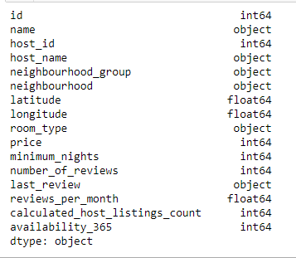
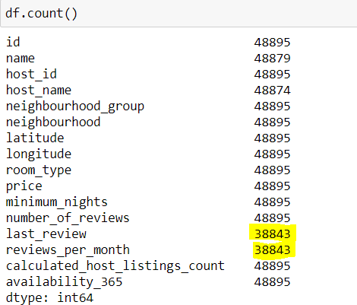
New York Airbnb Case Study
Data Understanding:
There are 16 Variables in the Data of which 10 are Numeric Columns, 5 are Categorical and 1 is a
Date column.

Slide 2
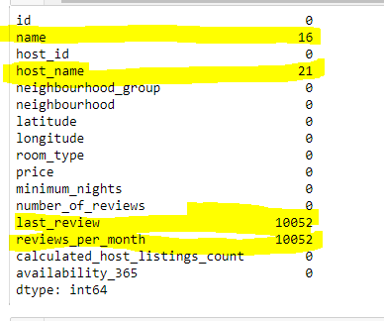

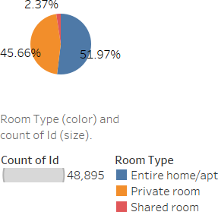
Handling Missing Values:
last review and reviews per month have 20% missing values, we can drop them so that it won’t Impact the Analysis.
Data Analysis and Visualization:
Analysis is done based on Customer Preferences i.e., Room Type, Prices and Regions to get Insights which will be useful for the Business in Post Covid Period.
Customer Preferences of Room Types:

Slide 3
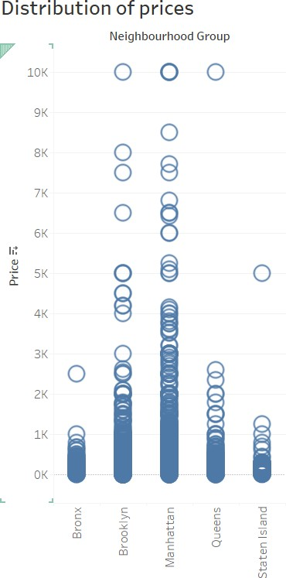
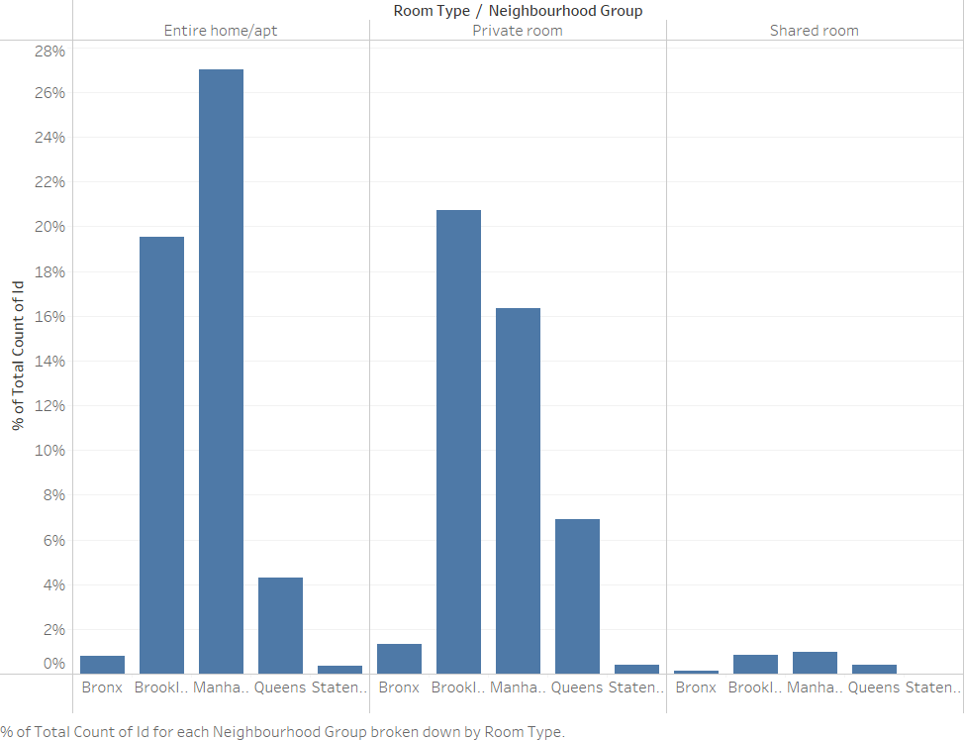
Customers Prefer Properties with Lower Prices across all regions
Customer Preferences Based on Region and Room Type:

Slide 4
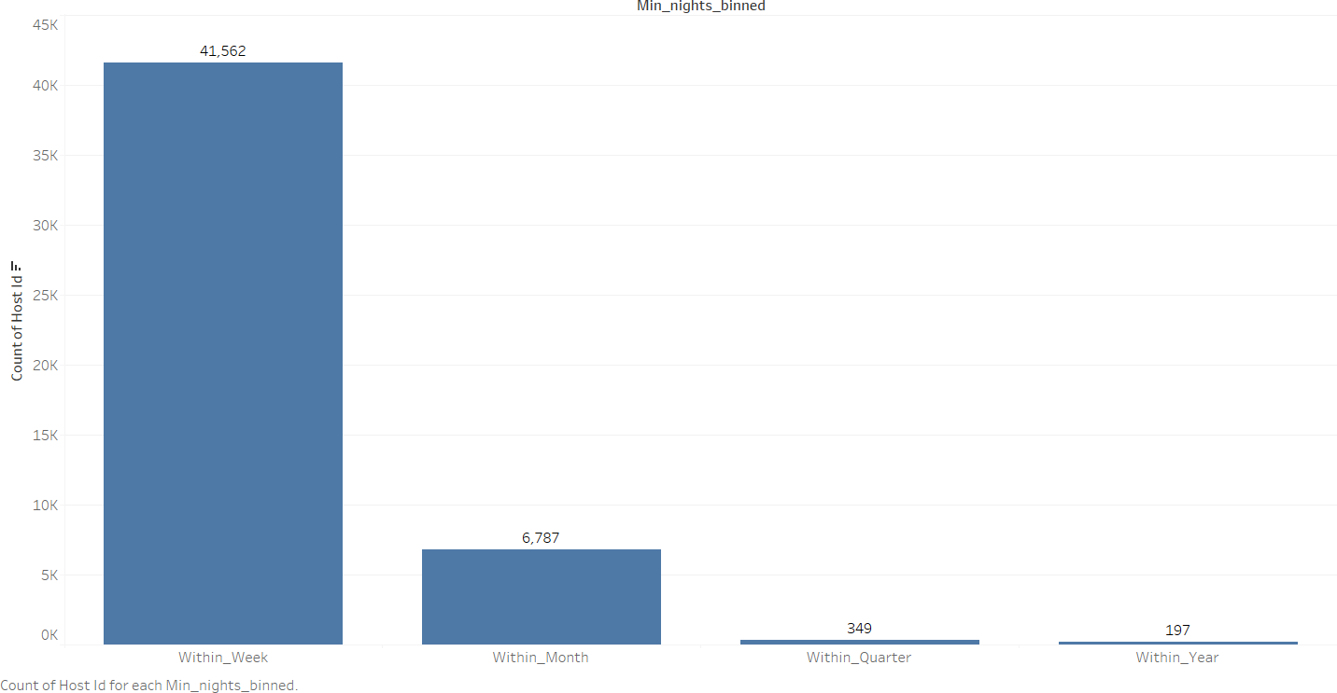
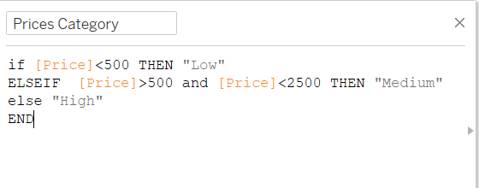
Preference based on Min no of Nights:
Data Methodology:
Binning is done on Prices and Min no of Nights Variable to get the segments which have high/low Priority as per Customer Preference.

Slide 5
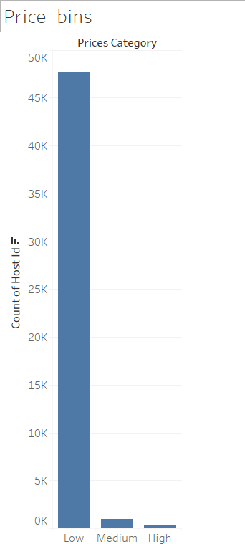
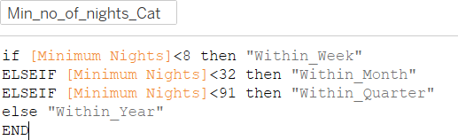
Minimum number of nights Binning:

Slide 6
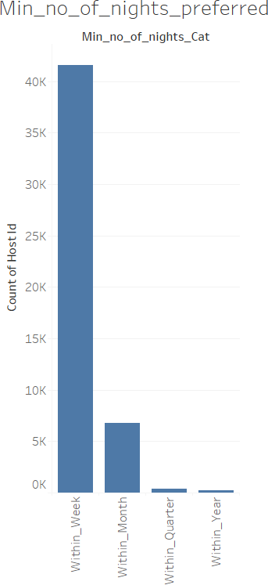
Business Understanding:
Airbnb has seen a major decline in revenue due to COVID-19 pandemic, now since people have
started to travel more Airbnb wants to make sure that it is fully prepared for this change.
This Airbnb ('AB_NYC_2019') dataset for the 2019 year appeared to be a very rich dataset with a variety of columns that allowed us to do deep data exploration on each significant column presented.
First, we have found hosts that take good advantage of the Airbnb platform and provide the most listings; we found that our top host has 327 listings.
After that, we proceeded with analysing boroughs and neighbourhood listing densities and what areas were more popular than another. Next, we put good use of our latitude and longitude columns and used to create a geographical heat map color-coded by the price of listings.
Further, we came back to the first column with name strings and had to do a bit more coding to parse each title and analyse existing trends on how listings are named as well as what was the count for the most used words by hosts. Lastly.

Slide 7
Tool used for Data wrangling: Python
Tool used for Binning and Visualization: Tableau 2021.3
Prepared By:
Korakolla Umesh

